Slide 1
TypeScript Basic

Slide 2
Benefits of TypeScript
TypeScript is a superset of JavaScript that gives you advantages like:
Optional static typing (the key here is optional)
Decrease of bugs by 15%(if compare with JavaScript)
Better performance (does not have a cast, as in javascript)
Access to ES6 and ES7 features, before they become supported by major browsers
The ability to compile down to a version of JavaScript that runs on all browsers
Notes:
Optional Static Typing
Most likely, the first thing that comes to mind with TypeScript is the optional static type system that it provides. Types can be added to variables, functions, properties, etc. This will help the compiler and show warnings about any potential errors in code, before an app is ever run. Types also help when using libraries and frameworks, as they let developers know exactly what type of data APIs expect. The key thing to remember about the type system is that it is optional. TypeScript does not force developers to add types they don’t want to add. However, as an app gets larger and more complex, types can provide some great advantages.

Slide 3
Typescript Initialization
There are two main ways to get the TypeScript tools:
Via npm or yarn (the Node.js package manager)
npm i –g typescript
yarn global add typescript
By installing TypeScript’s Visual Studio plugins
Compiling your code(firstly, create file with extension .ts)
tsc <file.name>

Slide 4
TypeScript configuration file
You’ll want to bring your TypeScript files together - both the code you’ll be writing as well as any necessary declaration files.
To do this, you’ll need to create a tsconfig.json. TypeScript config is very flexible and have many compiler options.
Notes:
Need Demonstration:
Show tsconfig our project.
typeRoots - List of folders to include type definitions from.
outDir - Redirect output structure to the directory.
module - Specify module code generation: "None", "CommonJS", "AMD", "System", "UMD", "ES6", "ES2015" or "ESNext".
target - Specify ECMAScript target version: "ES3"(default), "ES5", "ES6"/"ES2015", "ES2016", "ES2017" or "ESNext".
lib - List of library files to be included in the compilation.
sourceMap - Generates corresponding .map file.
allowJs - Allow JavaScript files to be compiled.
jsx - Support JSX in .tsx files: "React" or "Preserve”
moduleResolution - Determine how modules get resolved. Either "Node" for Node.js/io.js style resolution, or "Classic".
rootDir - Specifies the root directory of input files. Only use to control the output directory structure with --outDir.
forceConsistentCasingInFileNames - Disallow inconsistently-cased references to the same file.
noImplicitReturns – Report error when not all code paths in function return a value.
noImplicitThis – Raise error on this expressions with an implied any type.
noImplicitAny – Raise error on expressions and declarations with an implied any type.
strictNullChecks – In strict null checking mode, the nulland undefined values are not in the domain of every type and are only assignable to themselves and any (the one exception being that undefined is also assignable to void).
suppressImplicitAnyIndexErrors – Suppress --noImplicitAny errors for indexing objects lacking index signatures.
noUnusedLocals – Report errors on unused locals.
skipLibCheck – Skip type checking of all declaration files (*.d.ts).
esModuleInterop – Emit __importStar and __importDefault helpers for runtime babel ecosystem compatibility and enable
allowSyntheticDefaultImports – Allow default imports from modules with no default export. This does not affect code emit, just typechecking.
strict – Enable all strict type checking options.
resolveJsonModule – Include modules imported with .jsonextension.
isolatedModules – Transpile each file as a separate module (similar to “ts.transpileModule”).
noEmit - Do not emit outputs.

Slide 5
Basic types
string
number
boolean
array
tuple
any
void
enum
never
null and undefined
object
type assertions
Notes:
Need Demonstration:
Open file TypeScriptExamples/basicTypes.ts

Slide 6
Functions
Functions are the fundamental building block of any applications in JavaScript. They’re how you build up layers of abstraction, mimicking classes, information hiding, and modules. In TypeScript, while there are classes, namespaces, and modules, functions still play the key role in describing how to do things. TypeScript also adds some new capabilities to the standard JavaScript functions to make them easier to work with.
Notes:
Need Demonstration:
Open file TypeScriptExamples/functions.ts

Slide 7
Interfaces and Classes
In TypeScript, interfaces fill the role of naming types, and are a powerful way of defining contracts within your code as well as contracts with code outside of your project.
Starting with ECMAScript 2015, also known as ECMAScript 6, JavaScript programmers will be able to build their applications using this object-oriented class-based approach(before we used functions and prototype-based inheritance to build up reusable components).
Notes:
Need Demonstration:
Open file TypeScriptExamples/interfacesAndClasses.ts

Slide 8
Generic
A major part of software engineering is building components that not only have well-defined and consistent APIs, but are also reusable. Components that are capable of working on the data of today as well as the data of tomorrow will give you the most flexible capabilities for building up large software systems.
One of the main tools in the toolbox for creating reusable components is generics, that is, being able to create a component that can work over a variety of types rather than a single one.
Notes:
Need Demonstration:
Open file TypeScriptExamples/generics.ts

Slide 9

Introducing JSX
Consider this variable declaration:
This funny tag syntax is neither a string nor HTML.
It is called JSX, and it is a syntax extension to JavaScript. We recommend using it with React to describe what the UI should look like. JSX may remind you of a template language, but it comes with the full power of JavaScript.
Notes:
React embraces the fact that rendering logic is inherently coupled with other UI logic: how events are handled, how the state changes over time, and how the data is prepared for display.
Instead of artificially separating technologies by putting markup and logic in separate files, React separates concerns with loosely coupled units called “components” that contain both. We will come back to components in a further section.

Slide 10
Embedding Expressions in JSX
In the example below, we declare a variable called userName and then use it inside JSX by wrapping it in curly braces:
You can put any valid JavaScript expression inside the curly braces in JSX. For example, 2 + 2, user.firstName, or formatName(user) are all valid JavaScript expressions.

Slide 11
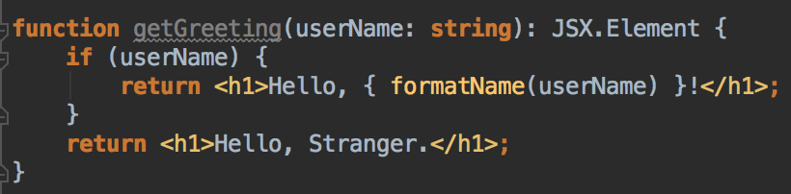
JSX is an Expression Too
After compilation, JSX expressions become regular JavaScript function calls and evaluate to JavaScript objects. This means that you can use JSX inside of if statements and for loops, assign it to variables, accept it as arguments, and return it from functions:

Slide 12
Specifying Attributes with JSX
You may use quotes to specify string literals as attributes:
You may also use curly braces to embed a JavaScript expression in an attribute:
Since JSX is closer to JavaScript than to HTML, React DOM uses camelCase property naming convention instead of HTML attribute names.
For example, class becomes className in JSX, and tabindex becomes tabIndex.
Notes:
Don’t put quotes around curly braces when embedding a JavaScript expression in an attribute. You should either use quotes (for string values) or curly braces (for expressions), but not both in the same attribute.

Slide 13
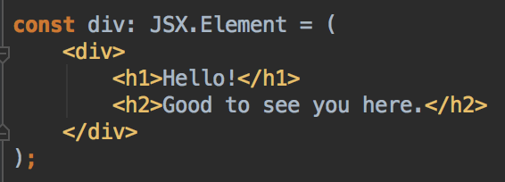
Specifying Children with JSX
If a tag is empty, you may close it immediately with />, like XML:
JSX tags may contain children:
Notes:
By default, React DOM escapes any values embedded in JSX before rendering them. Thus it ensures that you can never inject anything that’s not explicitly written in your application. Everything is converted to a string before being rendered. This helps prevent XSS (cross-site-scripting) attacks.

Slide 14
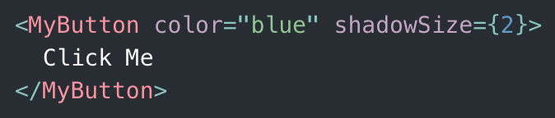
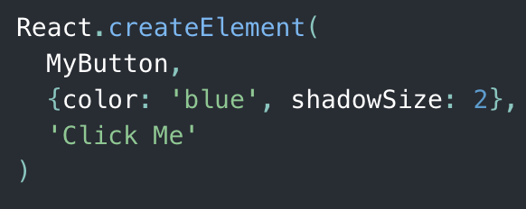
JSX in depth
Fundamentally, JSX just provides syntactic sugar for the React.createElement(component, props, ...children) function. The JSX code:
compiles into:
Notes:
Need Demonstration:
Open file TypeScriptExamples/JSX.tsx

